Slide 1
Most Common Security Threats to Mobile Devices

Slide 2
Security and Mobile Devices
Mobile initiatives are a top priority
Increase in mobility help enterprises improve operations and productivity.
Increases in organizational mobility typically result more no. of mobile devices accessing your systems from a remote location.
And for security teams, this means a growing variety of endpoints and threats they need to secure in order to protect organization from a data breach.
As in the past, the most common threats to mobile security include mobile malware.
Verizon’s 2020 Mobile Security Index Report shows, there are new threats organizations need to consider as well in order to ensure they’re protected.

Slide 3
Security and Mobile Devices
Some most common and critical mobile security threats::
Mobile Application Security Threats. Application-based threats happen when people download apps that look legitimate but actually skim data from their device. Examples are spyware and malware that steal personal and business information without people realizing it’s happening.
Web-Based Mobile Security Threats. Web-based threats are subtle and tend to go unnoticed. They happen when people visit affected sites that seem fine on the front-end but, in reality, automatically download malicious content onto devices.

Slide 4
Security and Mobile Devices
Mobile Network Security Threats. Network-based threats are especially common and risky because cybercriminals can steal unencrypted data while people use public WiFi networks.
Mobile Device Security Threats. Physical threats (to mobile devices ) most commonly refer to the loss or theft of a device. Because hackers have direct access to the hardware where private data is stored, this threat is especially dangerous to enterprises.

Slide 5
Mobile Threats and Protection
Most common examples of these threats, and the steps organizations can take to protect themselves from them
Social Engineering
Social engineering attacks are when bad actors send fake emails (phishing attacks) or text messages to the employees in an effort to trick them into handing over private information like their passwords or downloading malware onto their devices.
Reports by cybersecurity firm Lookout and Verizon show a 37% increase in enterprise mobile phishing attacks and that phishing attacks were the top cause of data breaches globally in 2020.

Slide 6
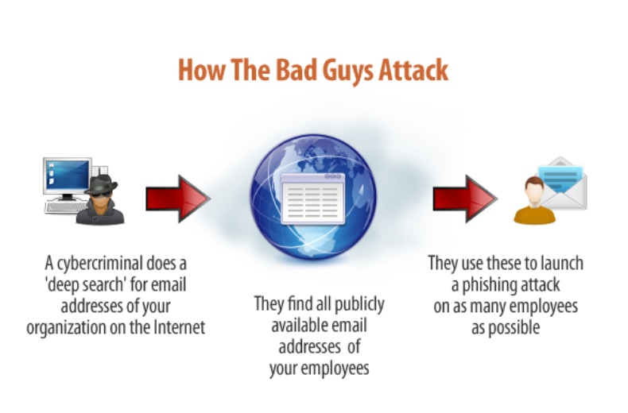
Mobile Threats and Protection

Slide 7
Mobile Threats and Protection
Social Engineering Attack Countermeasures
The best defense for phishing and other social engineering attacks is to teach employees how to spot phishing emails and SMS messages that look suspicious and avoid falling prey to them altogether.
Reducing the number of people who have access to sensitive data or systems and by restricting them not to use social apps while they are working, can also help protect the organization against social engineering attacks.. as it reduces the number of access points attackers have to gain access to critical systems or information.

Slide 8
Mobile Threats and Protection
Data Leakage via Malicious Apps
As Dave Jevans, CEO and CTO of Marble Security, explains, “Enterprises face a far greater threat from the millions of generally available apps on their employees’ devices than from mobile malware.”
That’s because 85% of mobile apps today are largely unsecured. Tom Tovar, CEO of Appdome, says, “Today, hackers can easily find an unprotected mobile app and use that unprotected app to design larger attacks or steal data, digital wallets, backend details, and other juicy bits directly from the app.”

Slide 9
Mobile Threats and Protection
For example, when your employees visit Google Play or the App Store to download apps that look innocent enough, the apps ask for a list of permissions before people are allowed to download them.
These permissions generally require some kind of access to files or folders on the mobile device, and most people just glance at the list of permissions and agree without reviewing them in great detail.
However, this lack of scrutiny can leave devices and enterprises vulnerable. Even if the app works the way it’s supposed to, it still has the potential to mine corporate data and send it to a third party, like a competitor, and expose sensitive product or business information.

Slide 10
Mobile Threats and Protection
How to Protect Against Data Leakage
The best way to protect your organization against data leakage through malicious or unsecured applications is by using mobile application management (MAM) tools.
These tools allow IT admins to manage corporate apps (wipe or control access permissions) on their employees’ devices without disrupting employees’ personal apps or data.

Slide 11
Mobile Threats and Protection
Unsecured Public WiFi
Public WiFi networks are generally less secure than private networks because there’s no way to know who set the network up, how (or if) it’s secured with encryption, or who is currently accessing it or monitoring it. And as more companies offer remote work options, the public WiFi networks your employees use to access your servers (e.g., from coffee shops or cafes) could present a risk to your organization.
For example, cybercriminals often set up WiFi networks that look authentic but are actually a front to capture data that passes through their system (a “man in the middle” attack).

Slide 12
Mobile Threats and Protection
Unsecured Public WiFi
How to Reduce Risks Posed By Unsecured Public WiFi
The best way for you to protect your organization against threats over public WiFi networks is by requiring employees to use a VPN to access company systems or files. This will ensure that their session stays private and secure, even if they use a public network to access your systems.

Slide 13
Mobile Threats and Protection
4. Internet of Things (IoT Devices)
The types of mobile devices that access your organization’s systems are branching out from mobile phones and tablets to include wearable tech (like the Apple Watch) and physical devices (like Google Home or Alexa).
And since many of the latest IoT mobile devices have IP addresses, it means bad actors can use them to gain access to your organizations’ network over the internet if those devices are connected to your systems.
For example, 78% of IT leaders from four different countries reported in a study by Infoblox that over 1,000 shadow IoT devices accessed their networks each day.

Slide 14
Mobile Threats and Protection
4. How to Combat Shadow IoT Threats
Mobile device management (MDM) tools can help you combat shadow IoT threats, as well as identity and access management (IAM) tools like Auth0.
However, IoT/Machine-to-Machine (M2M) security is still in a bit of a “wild west” phase at the moment. So it’s up to each organization to put the appropriate technical and policy regulations in place to ensure their systems are secure.

Slide 15
Mobile Threats and Protection
5. Spyware
Spyware is used to survey or collect data and is most commonly installed on a mobile device when users click on a malicious advertisement (“malvertisement”) or through scams that trick users into downloading it unintentionally.
Whether your employees have an iOS or Android device, their devices are targets ripe for data mining with spyware—which could include your private corporate data if that device is connected to your systems.

Slide 16
Mobile Threats and Protection
5. How to Protect Against Spyware
Dedicated mobile security apps (like Google’s Play Protect) can help your employees detect and eliminate spyware that might be installed on their devices and be used to access company data.
Ensuring your employees keep their device operating systems (and applications) up to date also helps ensure that their devices and your data are protected against the latest spyware threats.

Slide 17
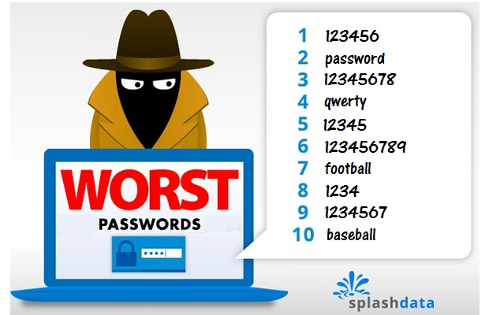
Mobile Threats and Protection
Poor Password Habits
A 2020 study by Balbix found that 99% of the people surveyed , reused their passwords between work accounts or between work and personal accounts. Unfortunately, the passwords that employees are reusing are often weak as well.
For example, a 2019 study by Google found that 59% of the people they surveyed used a name or a birthday in their password, and 24% admitted to using a password like one of these below:

Slide 18
Mobile Threats and Protection
How to Reduce or Eliminate Mobile Password Threats
The NIST Password Guidelines are widely regarded as the international standard for password best practices. Following these guidelines—and insisting your employees do the same—will help protect you against threats from weak or stolen passwords. Password managers can simplify the work required for your employees to follow these guidelines.
Requiring your employees to use more than one authentication factor (multi-factor authentication or MFA) to access mobile company applications will also help reduce the risk that a bad actor could gain access to your systems since they’d need to verify their identity with additional authentication factors in order to log in.

Slide 19
Mobile Threats and Protection
7. Lost or Stolen Mobile Devices
Lost and stolen devices aren’t a new threat for organizations. But with more people working remotely in public places like cafes or coffee shops and accessing your systems with a wider range of devices, lost and stolen devices pose a growing risk to your organization.
How to Protect Against Lost or Stolen Device Threats
First and foremost, you’ll want to ensure employees know what steps to take if they lose their device. Since most devices come with remote access to delete or transfer information, that should include asking employees to make sure those services are activated.

Slide 20
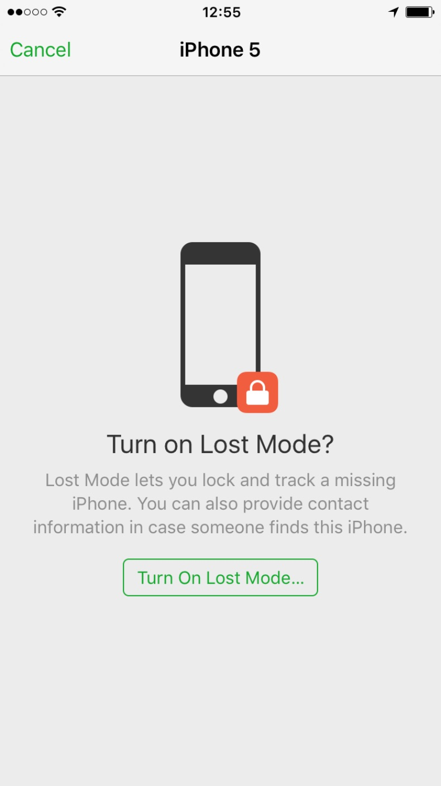
Mobile Threats and Protection
7. Lost or Stolen Mobile Devices
Mobile Device Management (MDM) tool can also help to secure, encrypt, or wipe sensitive company information from a device that’s lost or stolen, so long as those tools were installed before the device went missing.

Slide 21
Mobile Threats and Protection
8. Out of Date Operating System
Mobile security requires continuous work to find and patch vulnerabilities that bad actors use to gain unauthorized access to your systems and data.
Companies like Apple and Google address a lot of these vulnerabilities with operating system updates. For example, in 2016, Apple realized it had three zero-day vulnerabilities that left its devices open for spyware attacks and released a patch to protect users against these vulnerabilities.

Slide 22
Thank you !

